Slide 1

Smart Prediction of Engineering Streams Based on Student Counselling Data -A Data Mining Approach.
SESHADRI RAO GUDLAVALLERU ENGINEERING COLLEGE
Department of Computer Science And Engineering
Under the Enviable and Esteemed Guidance of
Dr. M. Babu Rao, M.Tech ,Ph.D.
Assistant Professor
By
Ch. Surya Vamsi (22481A0542)
G. Revathi (22481A0557)
D. Sarika (22481A0548)
A. Veladri (22481A0512)

Slide 2
ABSTRACT…..
This project focuses on automating the classification of engineering aspirants into suitable branches based on their demographic and academic attributes. Traditional manual methods of analyzing student data are time-consuming and often miss hidden patterns. To address this, machine learning techniques are applied to predict the most appropriate branch (such as CSE, ECE, ME, etc.) using inputs like rank, category, gender, and locality. The goal is to enhance fairness in branch allocation, support better counseling decisions, and improve institutional planning through accurate and data-driven predictions.

Slide 3
REQUIREMENTS…..
Hardware Requirements:
Processor: Intel i5 or higher (recommended: i5/i7 for faster performance)
RAM: Minimum 4 GB (recommended: 8 GB or higher for handling larger datasets)
Hard Disk: At least 1 GB of free space for Orange and dataset storage
Display : Minimum 1024x768 resolution
Operating System: Windows 10 or higher / macOS / Linux (64-bit)
Software Requirements:
Orange Data Mining Tool:isual data analysis and modeling (version 3.x recommended)
Microsoft SSMS:Managing and querying relational databases (SQL Server)
MicrosoftVisualStudio:Development and integration environment for coding
Microsoft Excel / CSV Tool:For dataset formatting and conversion

Slide 4
PROBLEM STATEMENT…..
The classification of engineering aspirants based on their demographic and academic attributes is crucial for streamlining branch allocation and enhancing academic guidance systems. However, manual analysis of student profiles is time-consuming and may not accurately capture hidden patterns in selection behavior. This project aims to develop a machine learning model to classify students into different engineering branches (e.g., CSE, ECE, ME, etc.) based on their attributes such as rank, category, gender, and locality, ensuring fair allocation, improved counseling processes, and optimized institutional planning.

Slide 5
Fields in dataset….. 1.Name 2.gender 3.categories 4.rank 5.counseling round 6.local/non-local 7.annual income 8.branch

Slide 6
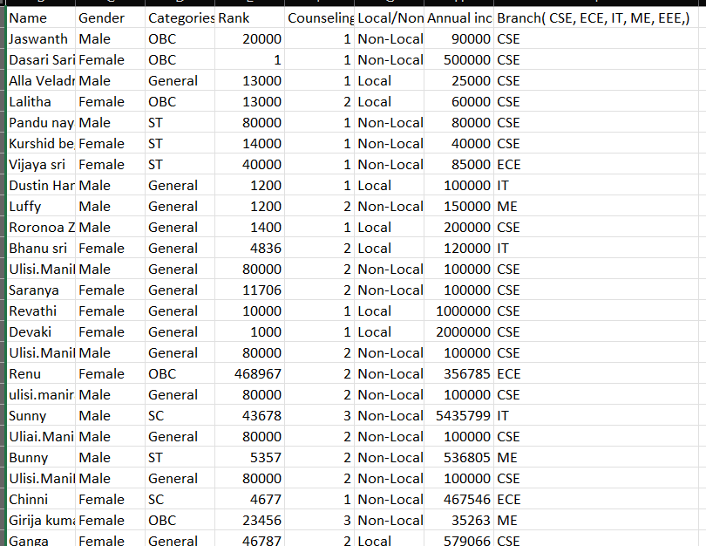
Dataset…..
Dataset is collected Using Google Form.
Link:https://docs.google.com/forms/d/e/1FAIpQLSeCNCwD9ePbhzzswE8Wby2nSqgd0TJtm8KHFsTozrq4GdDCQA/viewform?usp=sharing

Slide 7
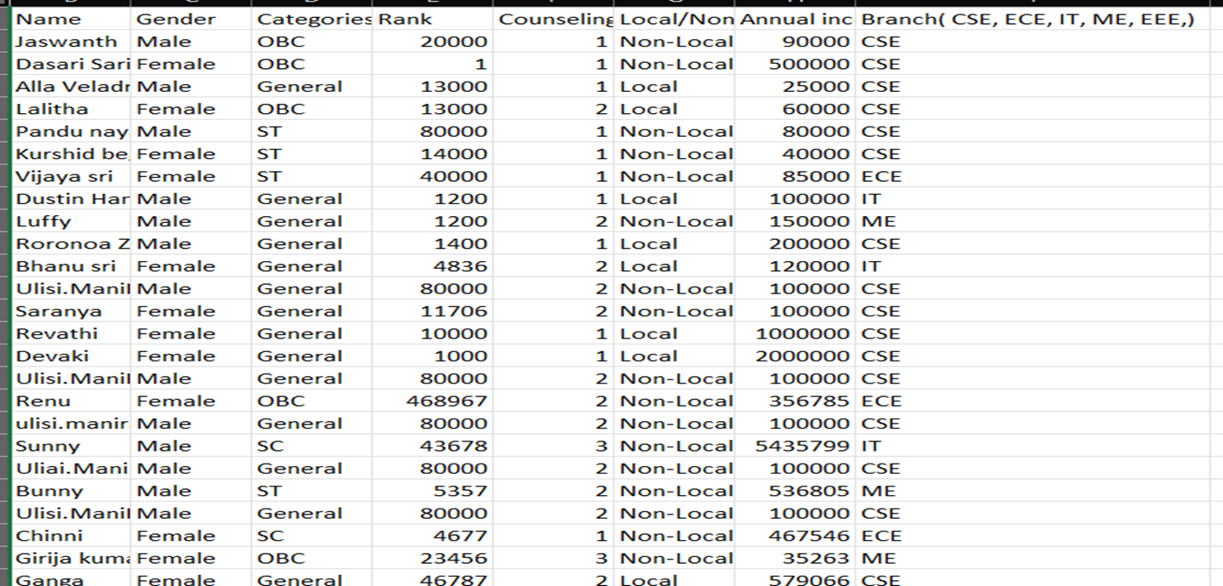
Preprocessing of dataset…..
Preprocess the Dataset Using Orange Tool.
Before imputing

Slide 8
AFTER IMPUTING…..

Slide 9
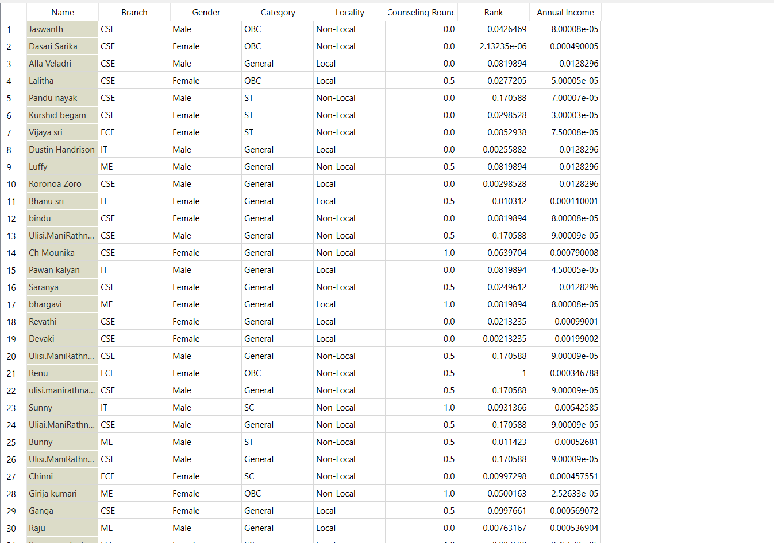
Normalized the numerical values using Normalization[0,1]
After normalization…

Slide 10
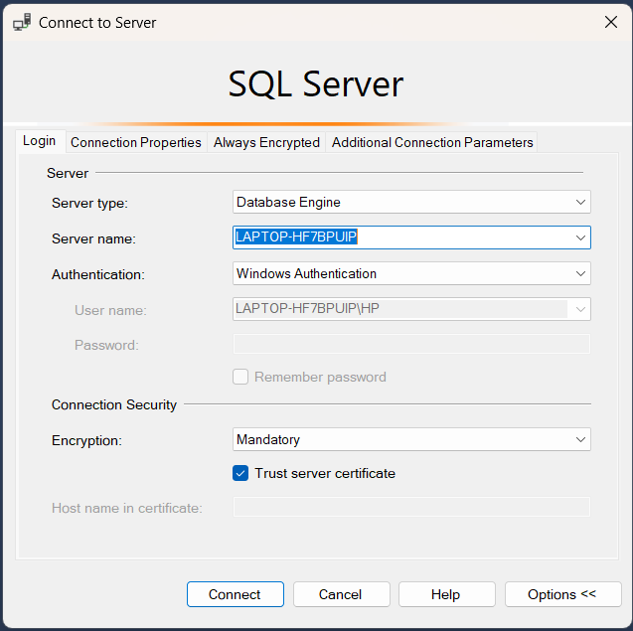
Schema Creation using SQL (SSMS)…..
Part-A.
Used SQL Server Management Studio (SSMS)
Designed tables for Fact & Dimension models
Key Actions Performed:
Wrote SQL queries to create schemas
Inserted preprocessed data into tables
Created relationships between tables using foreign keys
Created Star, Snowflake & Fact Constellation Schemas
Used SQL Server for schema creation and data insertion
Visualized schemas in Visual Studio (Cubes & Relationships)
Schema Types Implemented:
Star Schema
Snowflake Schema
Fact Constellation Schema

Slide 11
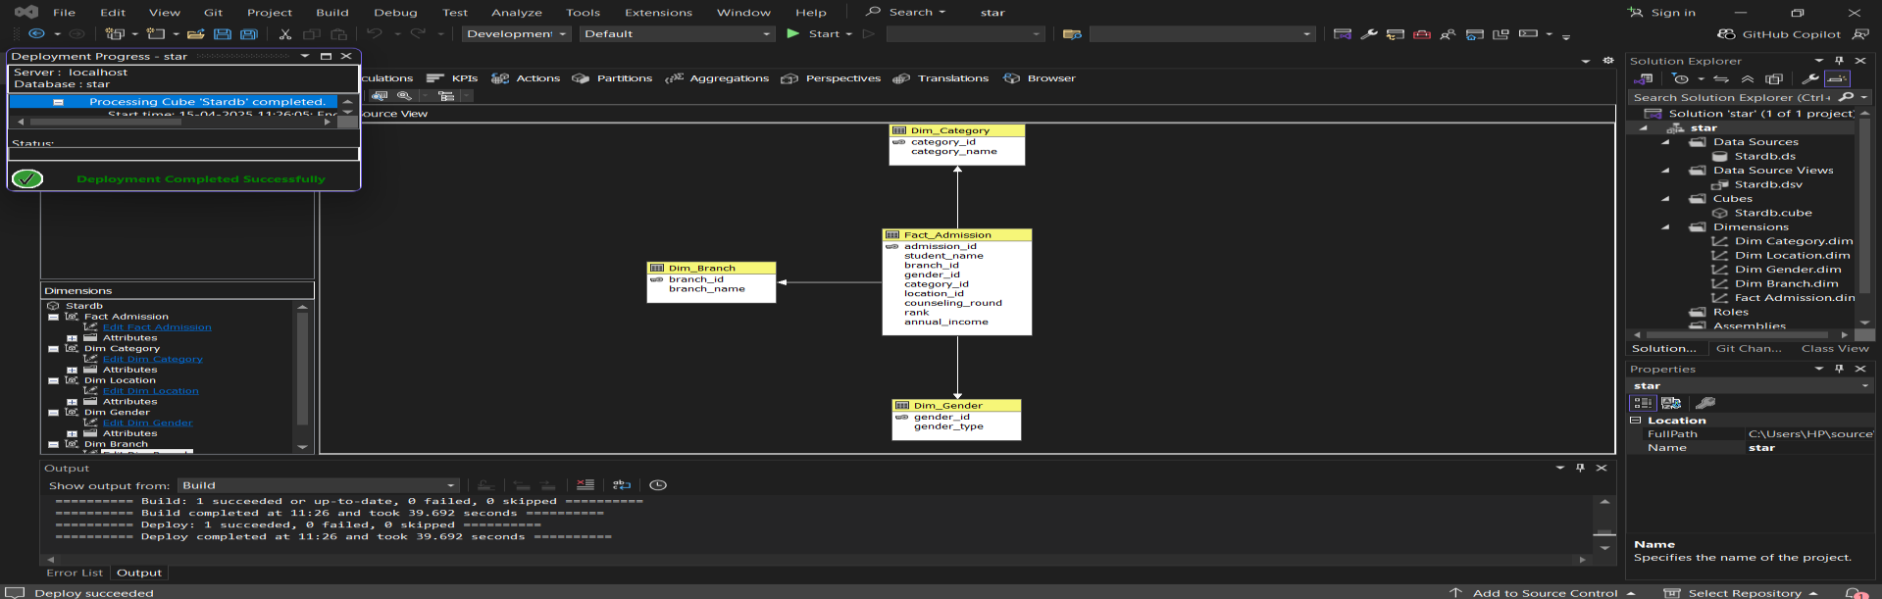
Data Warehouse & Schema Design …..
STAR SCHEMA.
We created 3 dimension tables and 1 fact table and inserted the values in to the attributes
Dimension Tables:
1.Dim_Branch
2.Dim_Category
3.Dim_Gender
Fact Table:
Fact_Admission

Slide 12
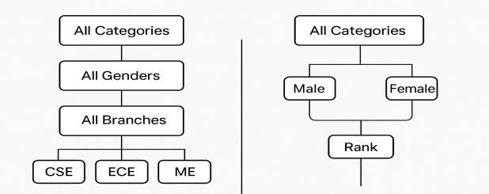
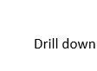
Concept Hierarchy used in star schema…..

Slide 13
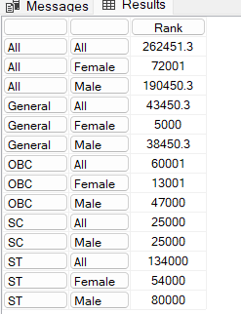
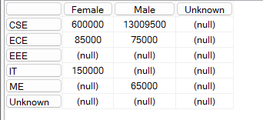
OLAP Operations & Schema Deployment…..
Deployed schemas on SSAS via Visual Studio.
Performed OLAP operations:
Drill-Down – explore detailed data.
Roll-Up – aggregate to higher-level data.
Slice & Dice – analyze data from multiple perspectives.
Pivot – Rearrange the data
1.Star schema..
Roll up:What is the average rank of students grouped by category and gender?
SELECT
NON EMPTY
{
([Dim Category].[Category Name].Members) *
([Dim Gender].[Gender Type].Members)
} ON ROWS,
[Measures].[rank] ON COLUMNS
FROM [Stardb]
Output:-
Output:-
-------------------------------------------------------------------------------------------------------
Pivot:The sum of Annual Income across Gender Type and Branch Name?
SELECT
{[Dim Gender].[Gender Type].Children} ON COLUMNS,
{[Dim Branch].[Branch Name].Children} ON ROWS
FROM [Stardb]
WHERE ([Measures].[Annual Income])

Slide 14
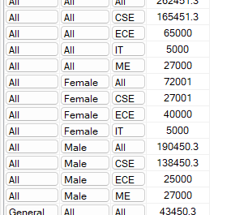
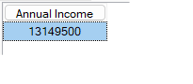
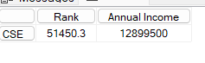
OLAP Operations & Schema Deployment…..
Output:-
Drill Down: What is the average rank of students for each combination of category, gender, and branch?
NON EMPTY
{
([Dim Category].[Category Name].Members) *
([Dim Gender].[Gender Type].Members) *
([Dim Branch].[Branch Name].Members)
} ON ROWS,
[Measures].[Rank] ON COLUMNS
FROM [Stardb]
------------------------------------------------------------------------------------------------
Output:-
Slice:The total Annual Income where Gender Type is 'Male'?
SELECT
{[Measures].[Annual Income]} ON COLUMNS
FROM [Stardb]
WHERE ([Dim Gender].[Gender Type].[Male])
---------------------------------------------------------------------------------------------
Output:-
Dice: Rank and Annual Income for students in 'CSE' branch who are 'Local’?
SELECT
{[Measures].[Rank], [Measures].[Annual Income]} ON COLUMNS,
{[Dim Branch].[Branch Name].[CSE]} ON ROWS
FROM [Stardb]
WHERE ([Dim Location].[Location Type].[Local])

Slide 15
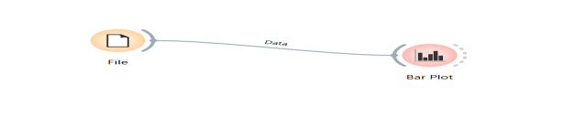
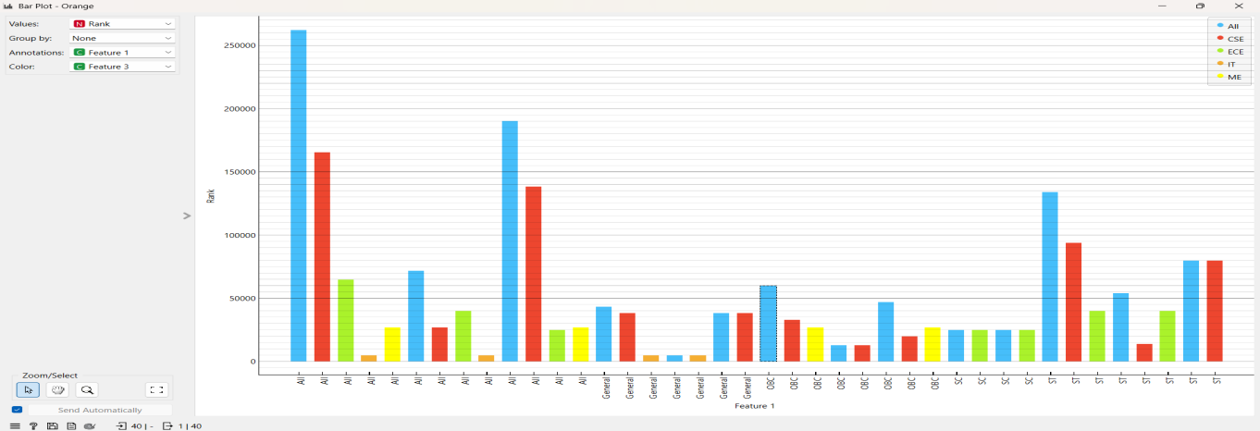
Visualize OLAP Results:

Slide 16
2.Snowflake schema For snowflake we had taken 5 dimensional tables and 1 fact table. Dimension Tables: 1,Dim_Gender 2.Dim_Branch 3.Dim_Category 4.Dim_Gender_details 5.dim_Branch_details Fact Tables: Fact_admission

Slide 17
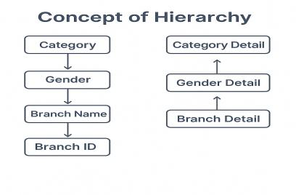
Concept Hierarchy used in Snow flake schema…..

Slide 18
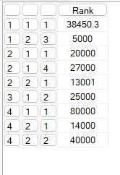
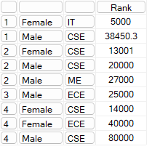
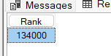
OLAP Operations & Schema Deployment…..
2.SnowFlake schema..
Roll up:What is the average rank when Gender Details are rolled up to Gender Type, considering different
Categories and Branches?
NON EMPTY
{
([Dim Category].[Category Id].[Category Id].Members) *
([Dim Gender].[Gender Id].[Gender Id].Members) *
([Dim Branch].[Branch Id].[Branch Id].Members)
} ON ROWS,
[Measures].[Rank] ON COLUMNS
FROM [Snowflakedb]
Output:-
-----------------------------------------------------------------------------------
Drill Down:How does the average rank vary when we drill down from Branch Name to Branch ID across different Categories and Genders?
SELECT
NON EMPTY
{
([Dim Category].[Category Detail Id].[Category Detail Id].Members) *
([Dim Gender Details].[Gender Type].[Gender Type].Members) *
([Dim Branch Details].[Branch Name].[Branch Name].Members)
} ON ROWS,
[Measures].[Rank] ON COLUMNS
FROM [Snowflakedb]
Output:-
----------------------------------------------------------------------------------------------
Slice:Slice for Category = "ST
SELECT
[Measures].[Rank] ON COLUMNS
FROM [Snowflakedb]
WHERE ([Dim Category Details].[Category Name].[ST])
Output:-

Slide 19
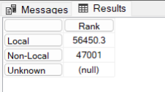
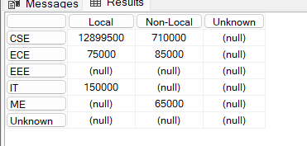
OLAP Operations & Schema Deployment…..
Dice:The total rank of students from "Local" and "Non-Local" locations, filtered for "General" and "OBC"
categories?
SELECT
[Measures].[Rank] ON COLUMNS,
[Dim Location Details].[Location Type].Children ON ROWS
FROM [Snowflakedb]
WHERE ({[Dim Category Details].[Category Name].[General],
[Dim Category Details].[Category Name].[OBC]})
Output:-
----------------------------------------------------------------------------------
Output:-
Pivot:The total annual income with branches as rows and locations as columns?
SELECT
[Dim Location Details].[Location Type].Children ON COLUMNS,
[Dim Branch Details].[Branch Name].Children ON ROWS
FROM [Snowflakedb]
WHERE ([Measures].[Annual Income])

Slide 20
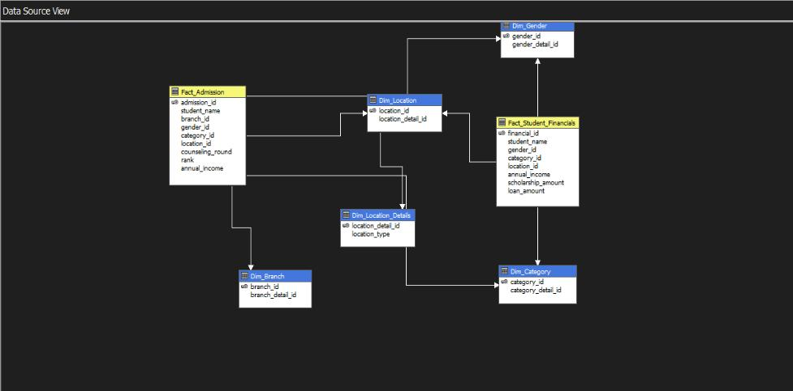
3. Fact Constellation Schema We created 5 dimension tables and 2 fact tables Dimension Tables: 1.Dim_location 2.dim_Category 3.dim_branch 4.dim_gender 5.dim_location_details fact tables: 1.fact_admission 2.fact_student_status

Slide 21
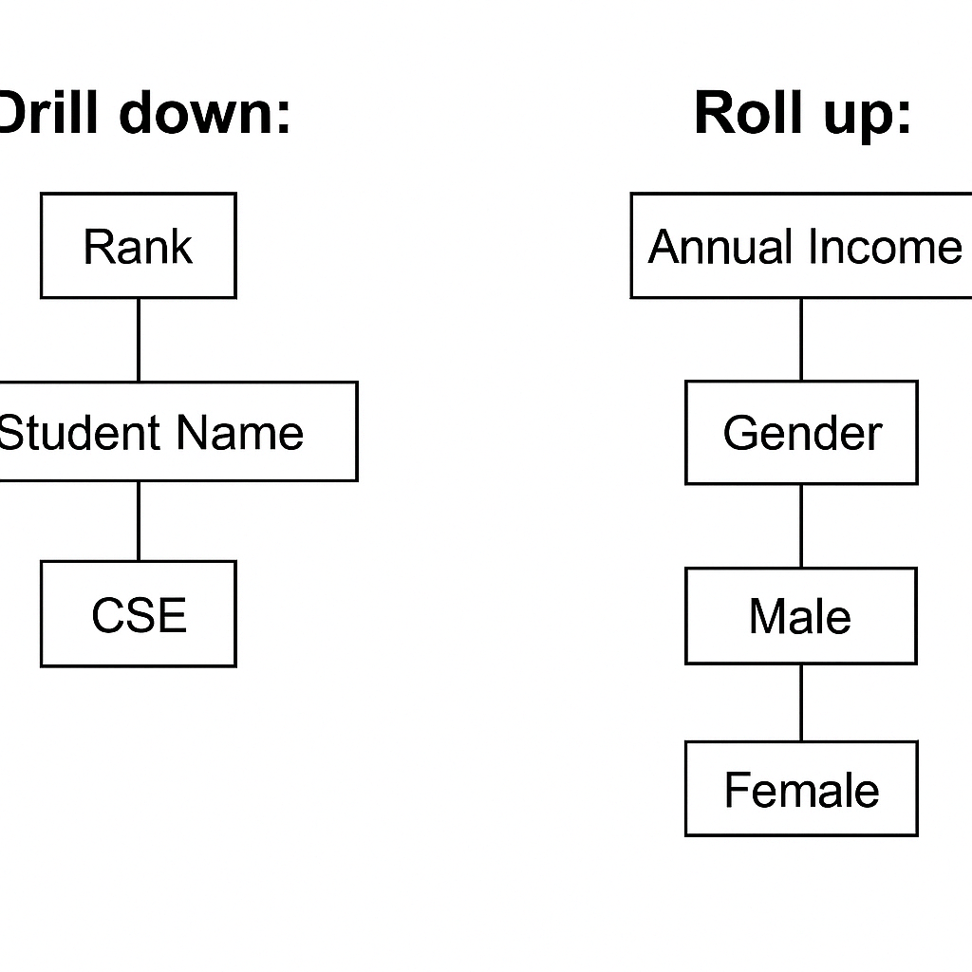
Concept Hierarchy used in FACTCONSTELLATION schema…..

Slide 22
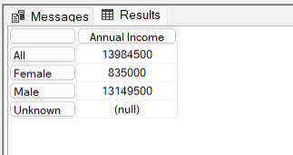
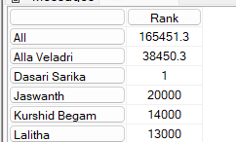
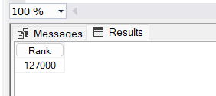
OLAP Operations & Schema Deployment…..
Roll up:What is the average annual income grouped by gender?
SELECT
[Measures].[Annual Income] ON COLUMNS,
[Dim Gender].[Gender Type].MEMBERS ON ROWS
FROM [Fact]
Output:-
-------------------------------------------------------------------------------
Output:-
Drill down: Show rank of all students in the CSE branch?
SELECT
[Measures].[Rank] ON COLUMNS,
[Fact Admission].[Student Name].MEMBERS ON ROWS
FROM [Fact]
WHERE ([Dim Branch].[Branch Name].[CSE])
-------------------------------------------------------------------------------
Output:-
Slice:What is the total rank of male students from non-local areas?
SELECT
[Measures].[Rank] ON COLUMNS
FROM [Fact]
WHERE (
[Dim Gender].[Gender Type].[Male],
[Dim Location].[Location Type].[Non-Local]
)

Slide 23
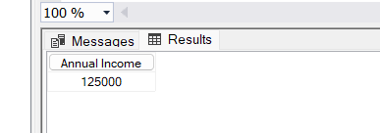
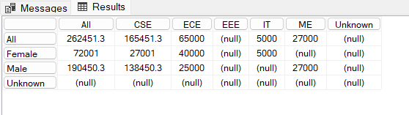
OLAP Operations & Schema Deployment…..
Dice:Find the total annual income of ST female students from EEE branch?
SELECT
[Measures].[Annual Income] ON COLUMNS
FROM [Fact]
WHERE (
[Dim Gender].[Gender Type].[Female],
[Dim Category].[Category Name].[ST],
[Dim Branch].[Branch Name].[EEE]
)
Output:-
--------------------------------------------------------------------------------------------
Output:-
Pivot:Compare rank of students across branch (columns) and gender (rows)?
SELECT
[Dim Branch].[Branch Name].MEMBERS ON COLUMNS,
[Dim Gender].[Gender Type].MEMBERS ON ROWS
FROM [Fact]
WHERE ([Measures].[Rank])

Slide 24
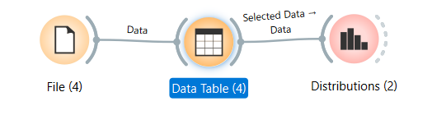
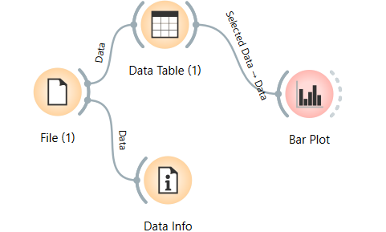
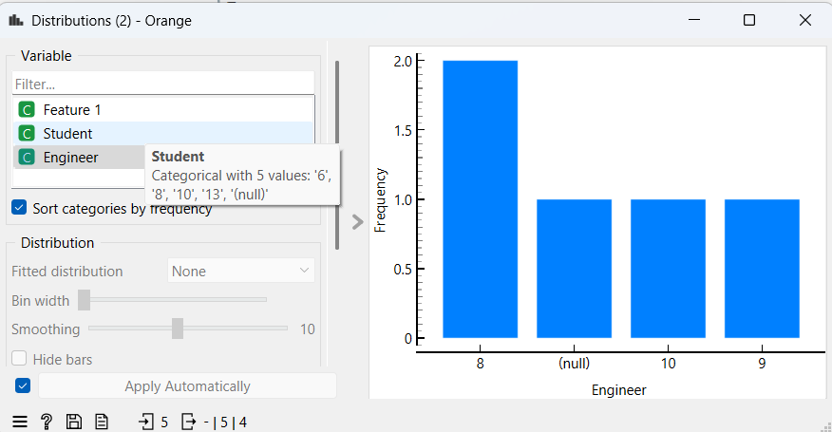
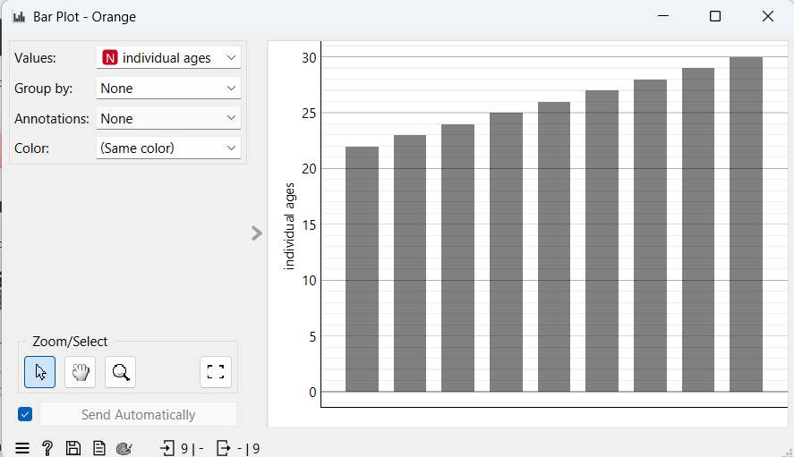
OLAP Operations & Visualization…..
OLAP results were exported and cleaned in Excel.
Handled missing values manually for accurate visual output.
Final visualizations created using Orange Tool to identify user trends and behaviors.

Slide 25
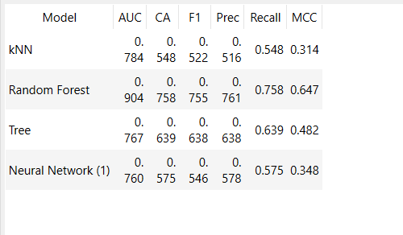
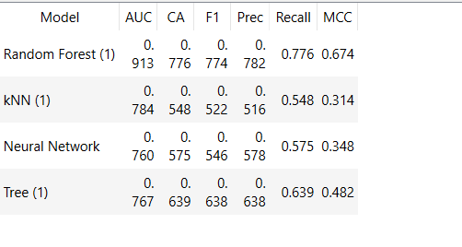
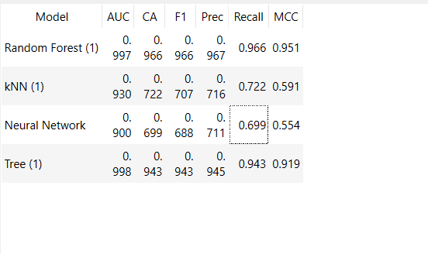
Perform Data Mining on the Dataset…..
Remove the noise data.
Apply preprocessing technique to the cleaned data.
And then use test score to decide that which model is best.
So then finally we can perform prediction.
Without preprocessing
With preprocessing
With preprocessing with data sampler
Random Forest has the most accuracy.

Slide 26
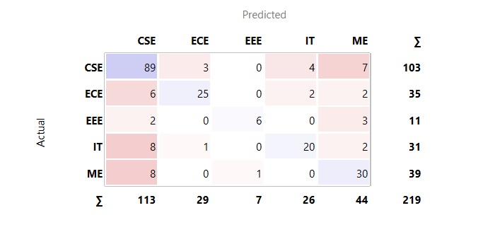
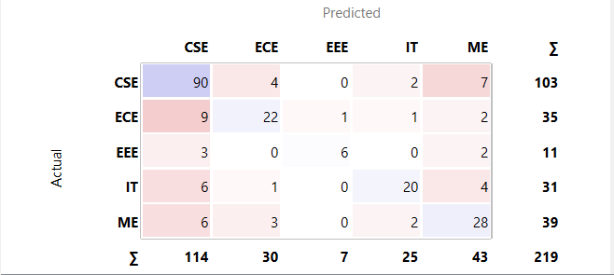
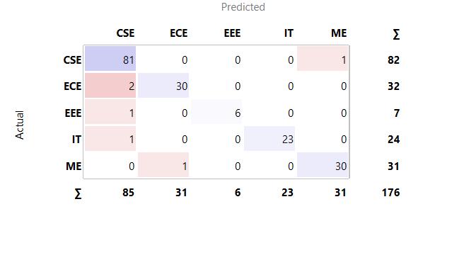
EVALUATION METRICS…..
With preprocessing
Without preprocessing
With preprocessing with data sampler

Slide 27
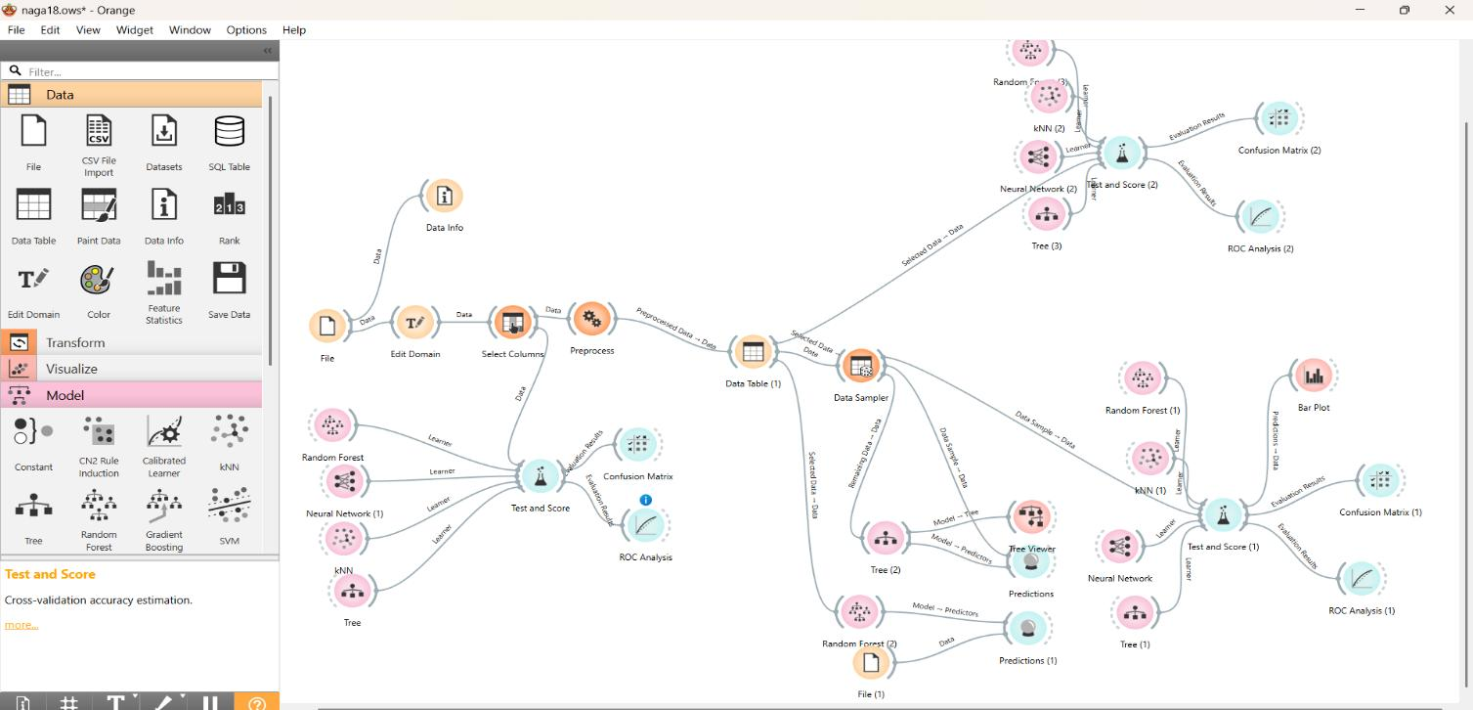
OVERALL WORKFLOW ……

Slide 28
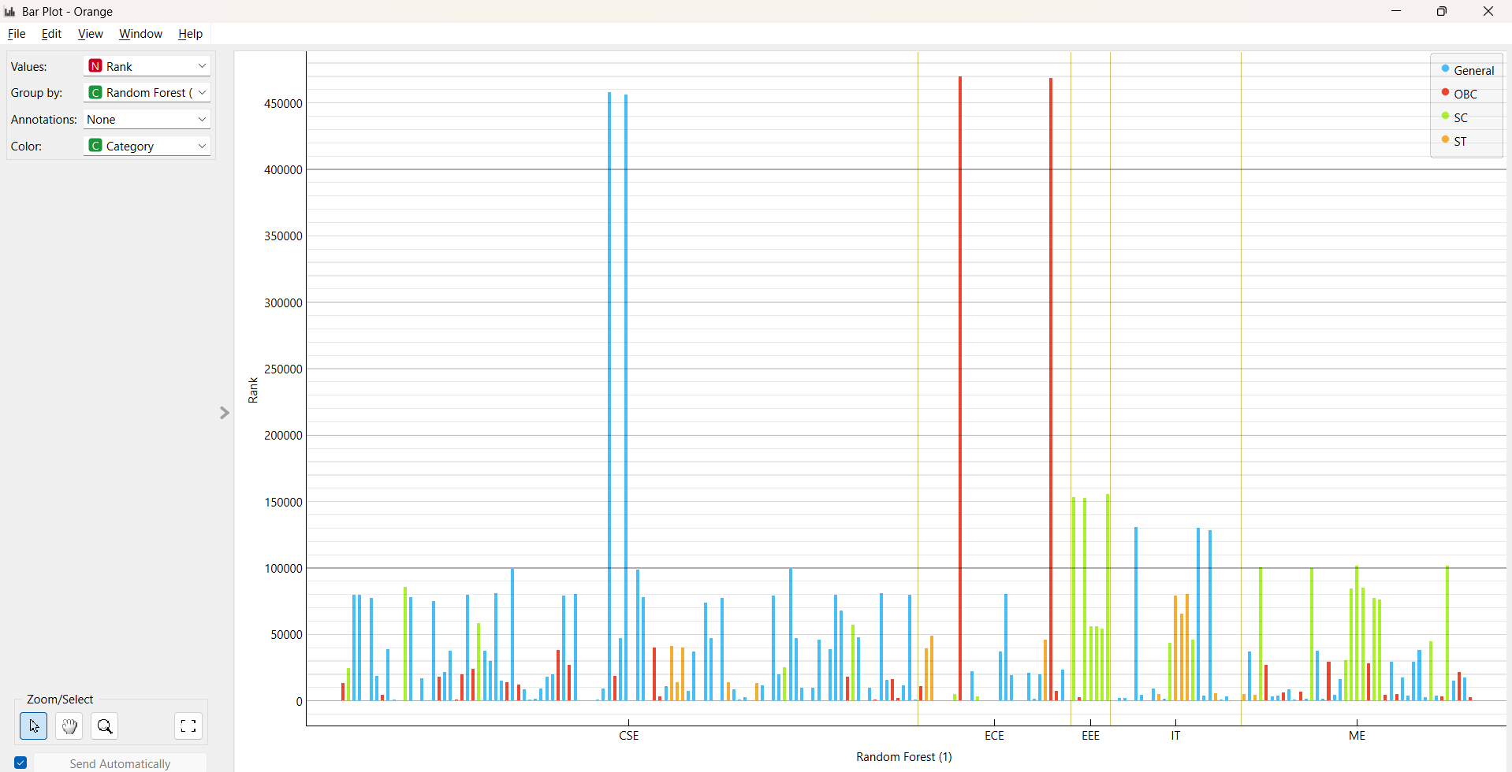
Bar plot –Analysis…..

Slide 29
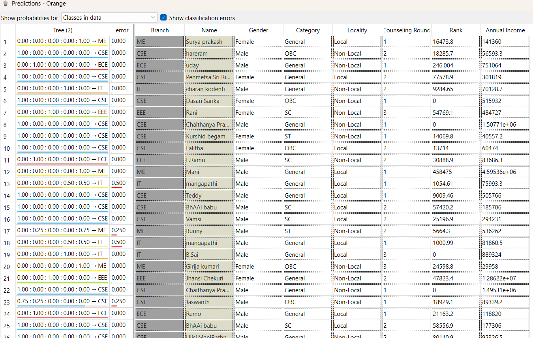
Predictions…..

Slide 30
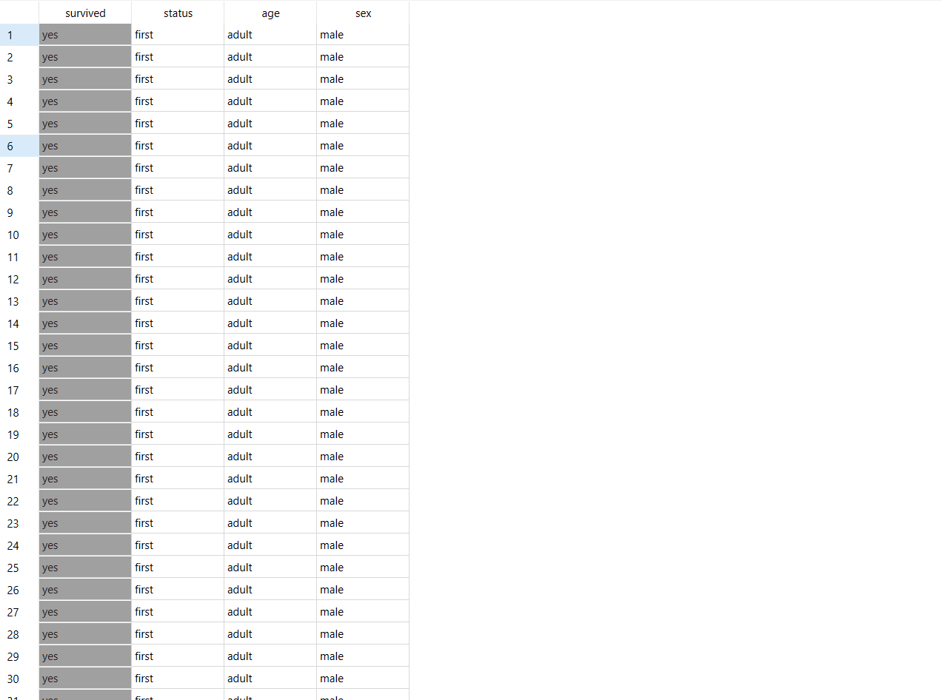
Survival Prediction on the Titanic Dataset using Orange TOOL
Part-B.
Dataset:
The Titanic Dataset contains detailed records of passengers aboard the Titanic, including attributes such as age, gender, class, fare, and survival status. This dataset is widely used in machine learning for classification tasks, particularly to predict the likelihood of a passenger's survival based on their personal and travel-related information. It serves as a classic benchmark for exploring data preprocessing, feature engineering, and model evaluation using Orange Data Mining.

Slide 31
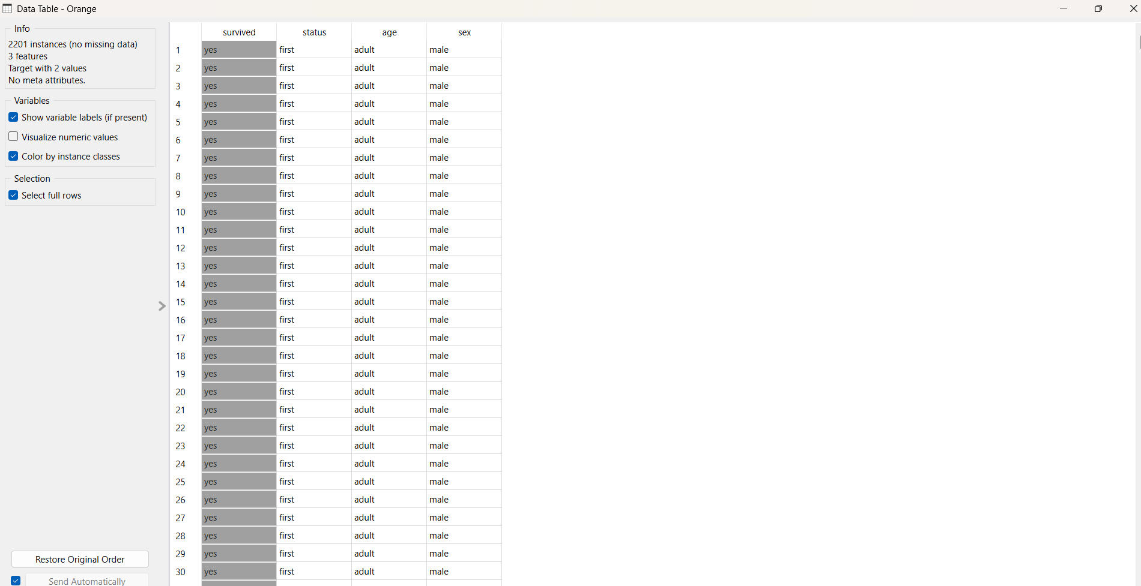
Preprocessing of Dataset…..

Slide 32
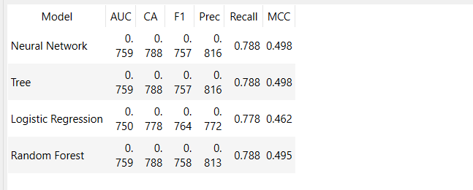
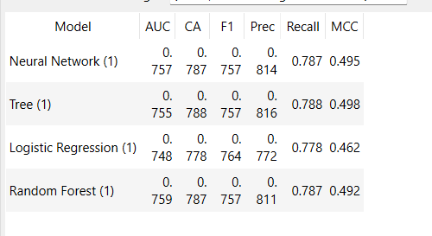
Test and Score values…..
Without preprocessing
With preprocessing

Slide 33
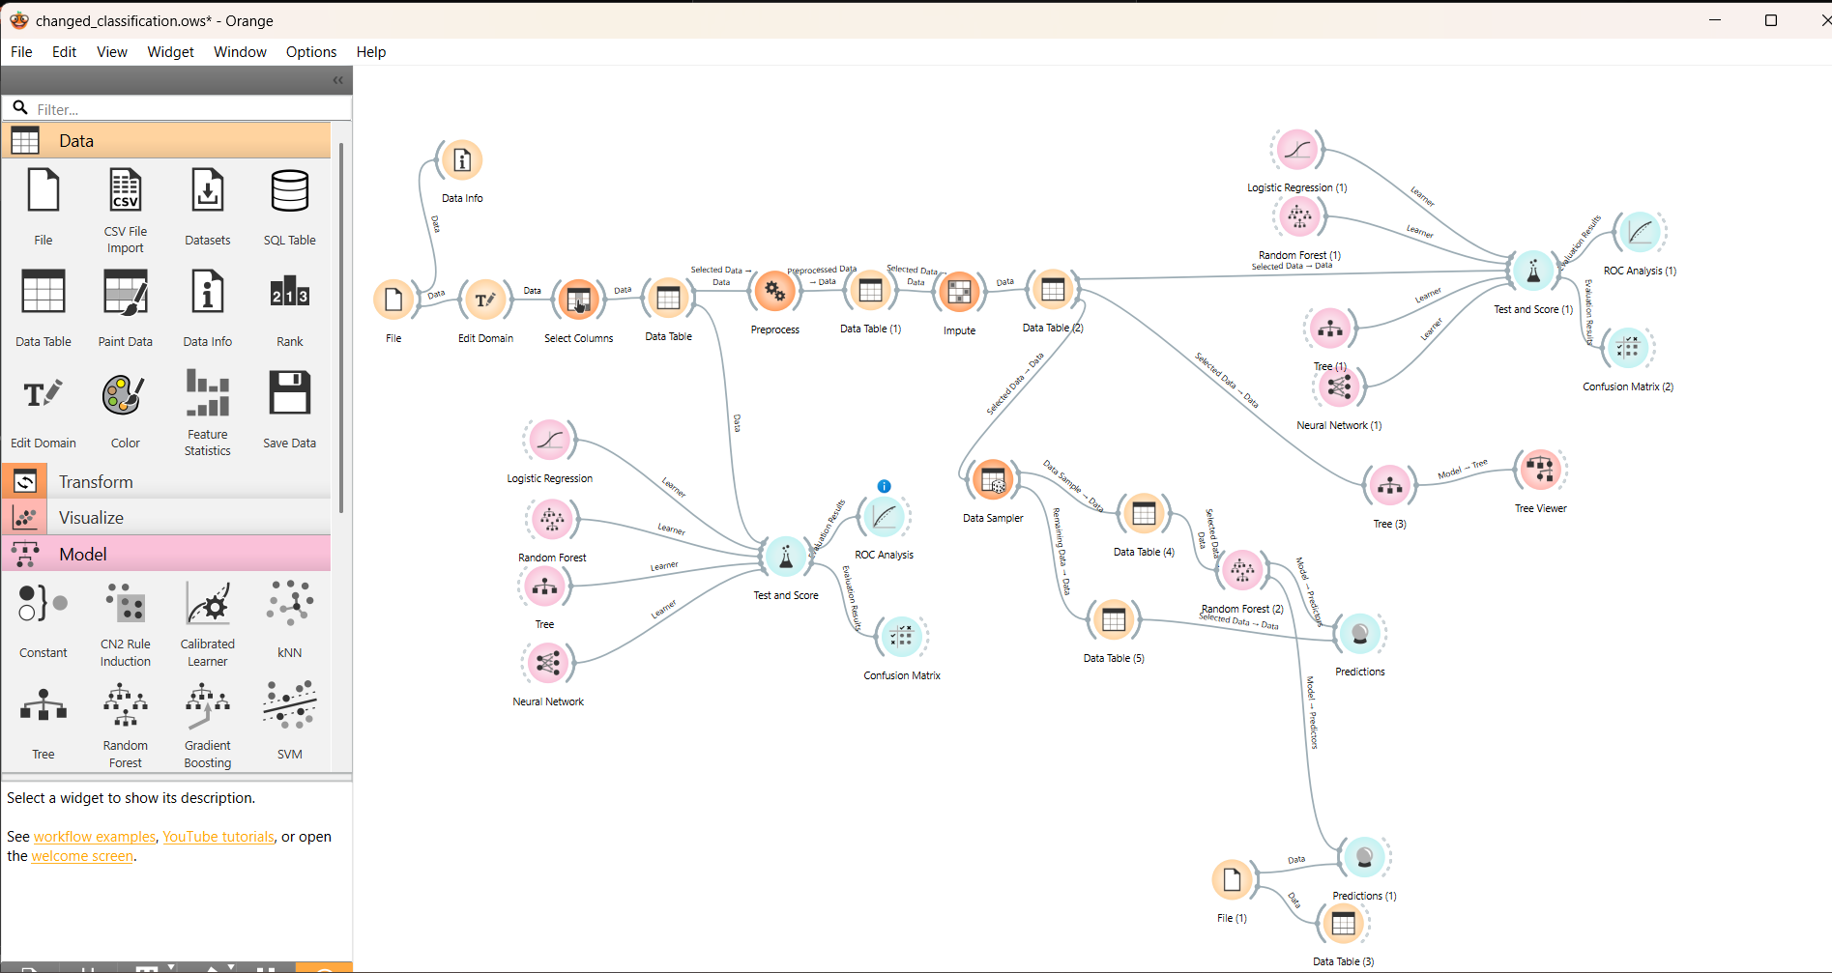
OVERALL WORKFLOW ……

Slide 34
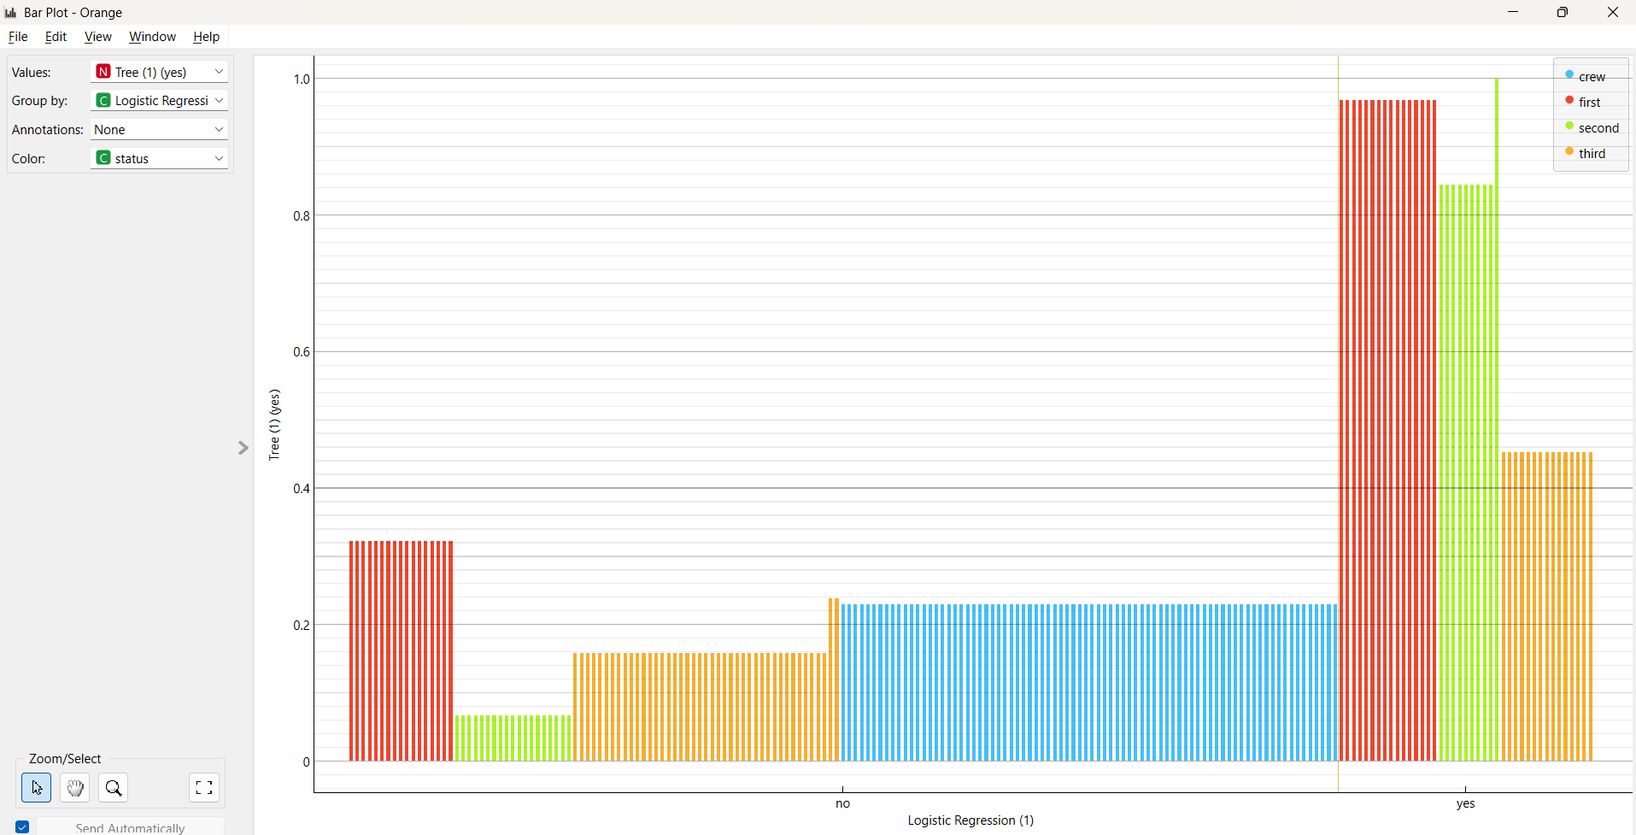
Bar plot-Analysis…..

Slide 35
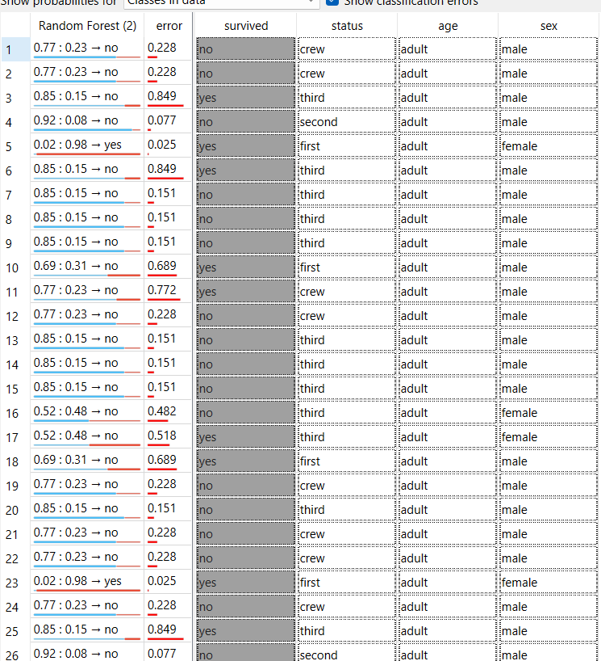
Predictions…..

Slide 36
FINAL ANALYSIS……
Part-C.
PART-A (CLASSIFICATION) • KNN •Decision Tree • Neural Network • Random Forest
Comparison done by: Classification Accuracy (CA), Confusion Matrix
PART-B (CLASSIFICATION) • Logistics Regression • Random Forest • Neural Network
• Comparison done by: Coefficient of Determination (R²)

Slide 37
CONCLUSION…..
This study involved two classification tasks using Orange Data Mining. Part A used the Admission Dataset to predict engineering streams, where Random Forest achieved the highest accuracy. OLAP and schema modeling provided useful insights into influential factors like rank and income.
Part B used the Titanic Dataset to predict survival. After preprocessing, Logistic Regression, Naive Bayes, and Neural Networks were applied, with Neural Networks performing best.
Overall, Random Forest and Neural Networks emerged as the top models. The results emphasize the role of data preparation and appropriate model selection for effective predictive analysis.

Slide 38
Thank you.

